Slide 1
Abstractive Text Summarization
By Abhinav yalamaddi
Reg.no: 17MIS7077
Under the guidance of Dr. D. Sumathi

Slide 2
Introduction
Abstractive text summarization is the task of generating a headline or a brief summary of a few sentences that captures the main points of an article or passage. We use the adjective 'abstractive' to describe a summary that is more than just a few existing passages or sentences extracted from the source, but a compressed paraphrasing of the main contents of the document, potentially using vocabulary not found in the source document.

Slide 3
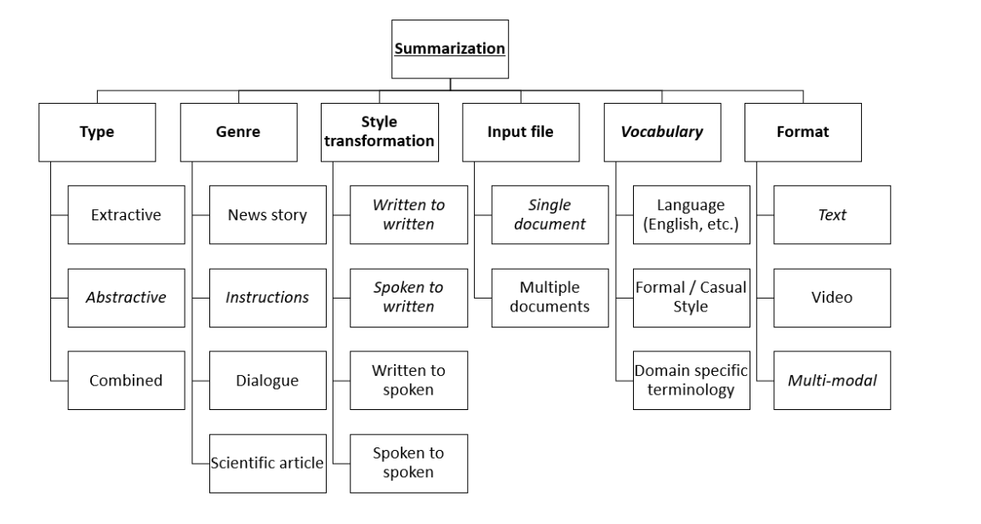

Slide 4
Problem definition
Abstractive summarization is the task of developing a summary of a few sentences that meaningfully captures the important context from given text input. It is one of the known difficult problems in NLP because summarization doesn't really involve selecting existing sentences from the input but rather paraphrasing the main contents of the document using previously unseen vocabulary.

Slide 5
Motivation
This project is aimed to emulate the baseline of state-of-the-art abstractive text summarization models in this work, with the goal of exploring different attention mechanisms once we had a good working baseline. We chose to draw inspiration from the IBM Watson team's sequence-to-sequence recurrent neural networks model (Nallapati et al., 2016), which achieved outstanding results by incorporating several novel features.
Ref: Nallapati, Ramesh, Bowen Zhou, Cicero Dos Santos, Caglar Gulcehre, and Bing Xiang. "Abstractive Text Summarization Using Sequence-to-sequence RNNs and Beyond."Proceedings of The 20th SIGNLL Conference on Computational Natural Language Learning (2016)

Slide 6
Objectives
The basic idea behind abstractive text summarization is to be able to extract a short subset of the most important information from a large set and present it in a human-readable format. As the amount of textual data on the internet grows, automatic text summarization methods have the potential to be very useful because more useful information can be read in a shorter amount of time.

Slide 7
Literature survey
Despite the clear differences that exist between abstractive summarization and machine translation, the attentional RNN encoder-decoder model proposed in (Bahdanau et al. 2014) has become the international standard in abstractive summarization. The encoder generates a representation of the input for both tasks, and the decoder uses these encodings to generate the final outputs.
Ref: Bahdanau, Dzmitry, Kyunghyun Cho, and Yoshua Bengio. "Neural Machine Translation by Jointly Learning to Align and Translate." [1409.0473] Neural Machine Translation by Jointly Learning to Align and Translate. N.p., 19 May 2016.
To generate target words, Nallapati et al. (2016) propose a bidirectional GRU encoder, a unidirectional GRU decoder, an attention mechanism over the source's hidden states, and a softmax layer over the vocabulary as a baseline model. In order to focus on attention, Nallapati then incorporates a number of features, including the large vocabulary trick, feature-rich encoding of key words, and the use of pointer networks to model rare words.
Ref: Nallapati, Ramesh, Bowen Zhou, Cicero Dos Santos, Caglar Gulcehre, and Bing Xiang. "Abstractive Text Summarization Using Sequence-to-sequence RNNs and Beyond."Proceedings of The 20th SIGNLL Conference on Computational Natural Language Learning (2016)

Slide 8
The “large vocabulary trick,” proposed by Jean et al., (2014), limits the decoder vocabulary of each mini-batch to words in the batch's source documents, thus speeding up convergence and addressing the computational bottleneck caused by the softmax computation over the entire vocabulary. It then adds words from the target dictionary to the decoder's vocabulary until it reaches a predetermined size. This method focuses the model on words from the source, making it useful for summarization.
Ref: Jean, Sébastien, Kyunghyun Cho, Roland Memisevic, and Yoshua Bengio. "On Using Very Large Target Vocabulary for Neural Machine Translation – Sampled Softmax."The Neural Perspective. N.p., 26 Oct. 2016.

Slide 9
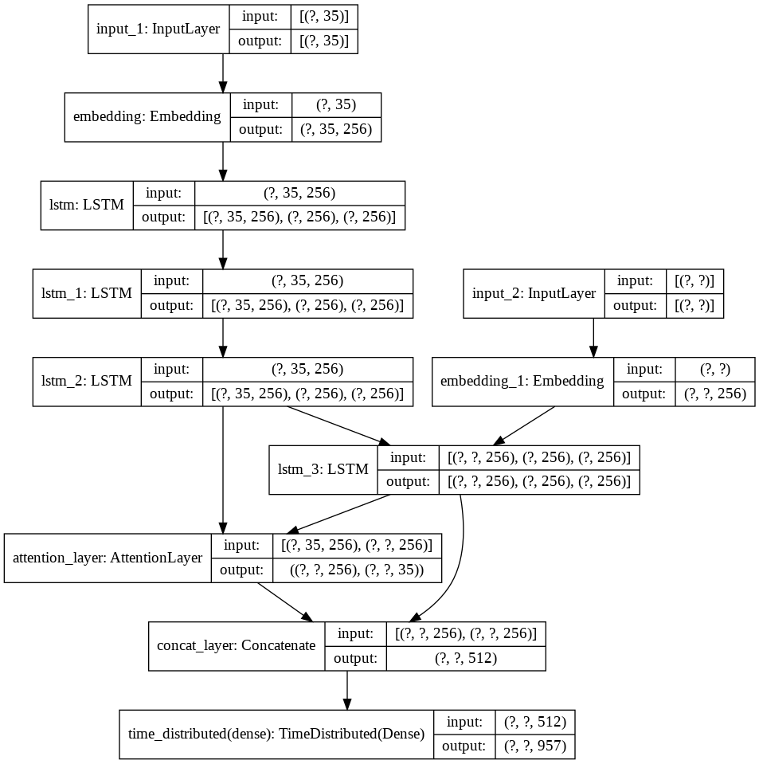
Design

Slide 10
Methodology
All three of the models implemented were built on an encoder-decoder RNN foundation. Experimented with different attention and word embedding initializations for our various models. GRU or LSTM cells are commonly used for the RNN encoder and decoder in abstractive summarization. We chose LSTM cells for their additional control via their memory unit, despite the fact that many top models use GRU cells for their faster computation time (Nallapati et al., 2016).

Slide 11
Implementation
Preprocessing and Dataset
We trained our model on the Amazon Fine Food Reviews dataset from Kaggle was used for this project, which contains 500,000 reviews from 1999 to 2012., which is commonly used for training models for abstractive summarization. During preprocessing, we pulled out 80% dataset and summary which gave, and we trained our model to predict the abstractive summary given the review given by the user.
Ref: https://www.kaggle.com/snap/amazon-fine-food-reviews/download
Model
A Three Layer Stacked LSTM Encoder-Decoder model with Global Attention Mechanism was used during implementation. On the training set, I was able to achieve an accuracy of 77.27 percent using this model (constituting 80 percent of the dataset). This model also achieved a cumulative BLEU-4 score of 0.8800 on the test set.
Notes:
Global attention, on the other hand, makes use of the output from the encoder and decoder for the current time step only. This makes it attractive to implement in vectorized libraries such as Keras.

Slide 12
Timeline
Stage | Week | Task
Code | 1 | Define Text Summarization
 |  | Resource allocation and related works
 | 2 | Algorithm implementation
 |  | Data cleaning
 | 3 | Algorithm enhancement
 | 4 | Code review
 |  | Benchmarking with other algorithms
QA | 5 | Record and documentation
 |  | Generating report analytics
 | 6 | General Algorithm enhancements
 |  | Grooming bugs
Release | 7 | Fixing bugs and code review
 | 8 | Review and grooming the code
 |  | Documentation
 |  | Final Code Review(possibility of enhancement)

